Slide 1
Preview
Quick overview of core pricing features, does not include all functionalities, features, or final product look

Slide 2

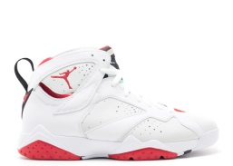
Interface
iOS Application
User
User
Admin
Found
Submit Payment
Shoe name
Enter Email
Info…
Air Jordan 7 Retro
"hare"
Find
SENDING…
Lowest Price: $300
Submit
Users submit shoe requests
Admin review and places order
Features:
Shoe Repository
Search Automation
IOS app interface (User)
Logs and status of search queries (Admin )
Personalized User profiles w/ search history
real-time availability (Admin and Clients)

Slide 3
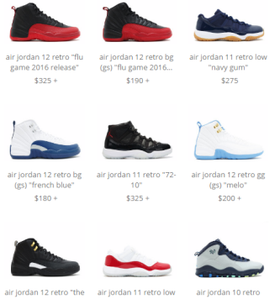
Interface Plus
iOS Application
Automatically Sent to signed in user
User/Admin
User
Found
Submit Payment
Shoe name
Email
Find
Info…
Air Jordan 7 Retro
"hare"
Lowest Price: $300
SENT
Sign In
Purchase
Complaints
Comments
Special Requests
Features:
Shoe Repository
Custom Search Functionality. ( Admin & Clients )
Desktop (Admin ) / IOS app interface (Admin & Client)
Logs and status of search queries (Admin & Clients)
Personalized User profiles w/ search history
real-time availability (Admin & Clients)
Catalog of available shoes
Full automation
Search
Purchase
Customer Reports
Available Now

